Slide 1
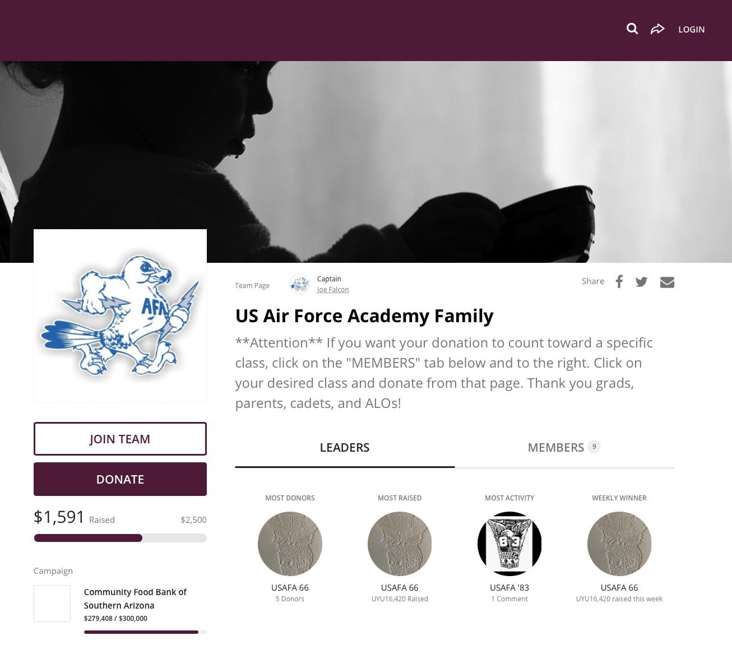
Step 1
Navigate to donate.communityfoodbank.org/USAFAfamily
Click on “Join Team”

Slide 2
Step 2
Click on ”Create an Account"

Slide 3
Step 3
Make an account by linking to your Facebook account or through an e-mail
When you click “Next” you’ll be taken to a window asking for your first and last names
Instead of your name, you’ll want to type a nickname for your page (See Step 8)
Don’t worry. You can change this later if you want

Slide 4
Step 4
Set you fundraising goal
Set the end date as May 2nd
Write something for a headline (you’ll see where that goes in a couple of slides from now)
Make a short URL. I recommend USAFAxx (xx=class year). That would make the link you send your classmates: donate.communityfoodbank.org/USAFAxx
Click “Finish”

Slide 5
Step 5
Add an avatar picture
300x300 pixels works best, but you can change the size once you upload it
Click “Continue”

Slide 6
Step 6
Click on “Manage” to make changes

Slide 7
Step 7
The only changes you’ll probably want to make are “Details” and maybe “Story”

Slide 8
Step 8
This is the “Details” tab
Your name will be in this box if you used it instead of a nickname on Step 3
You can also change the headline, goal, URL and the photo from this page too
Make sure you click on “Save Changes” at the bottom

Slide 9
I’m Lost. Now What?
If you can’t figure out how to get back to the “Manage” page—trust me, I’ve done this 100 times now—click on the little white circle and then click “My profile”

Slide 10
Step 9
That will take you to this page
Click on “View”

Slide 11
Finis
That will take you back to your page where you can click “Manage” and fix whatever you need to fix

